Slide 1
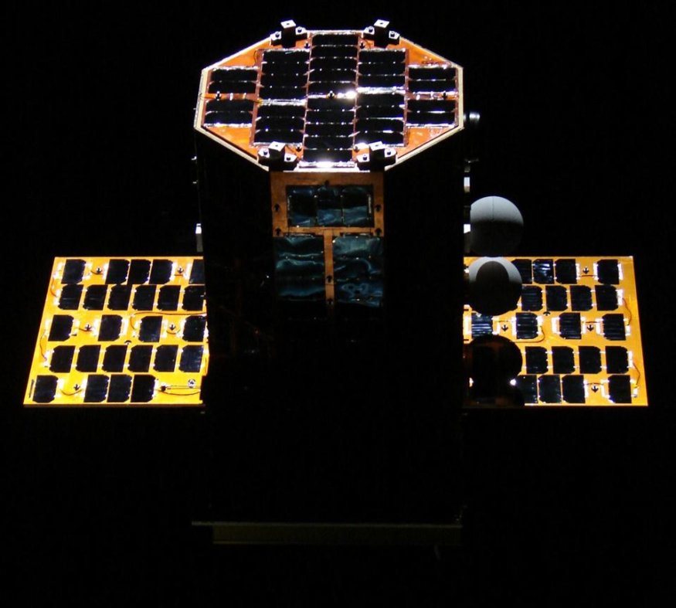

The University Nanosatellite Program: Oculus-ASR
NASA Jet Propulsion Lab
Summer Intern Cubesat Symposium
July 31st, 2013
Branden Ghena brghena@mtu.edu

Slide 2


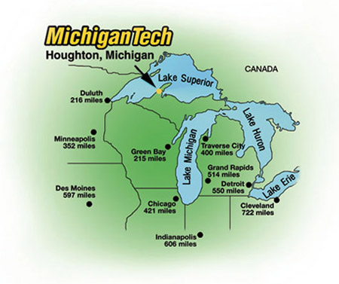

Michigan Tech
Located in Houghton, Michigan

Slide 3

Michigan Tech

Slide 4
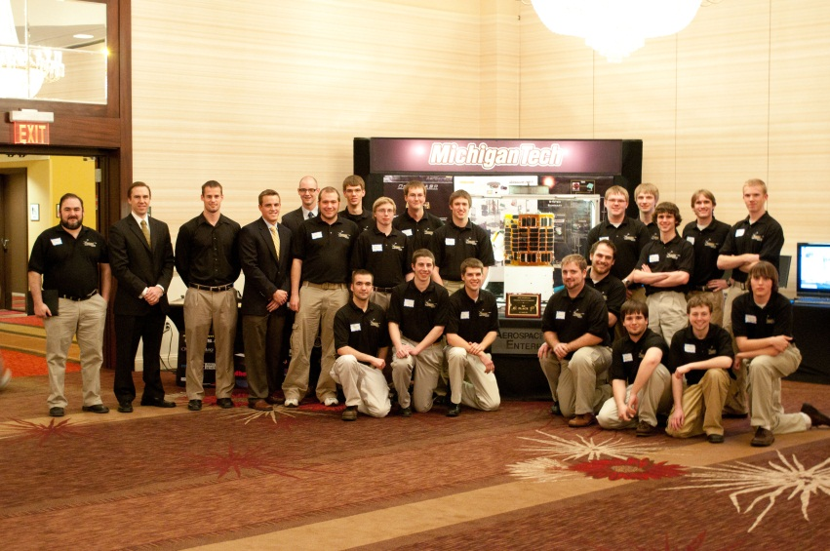
University Nanosatellite Program
Student Satellite Competition
Managed by Air Force Research Lab (AFRL)
2 years and $100k to complete a satellite
Nanosat-6: 2009-2011
Winner: Michigan Tech

Slide 5
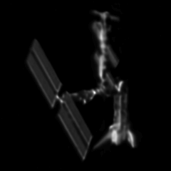
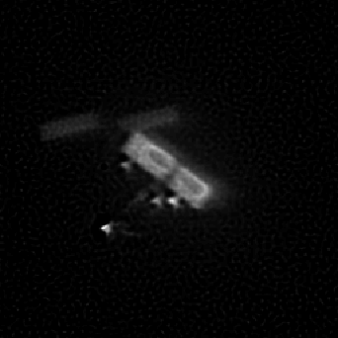
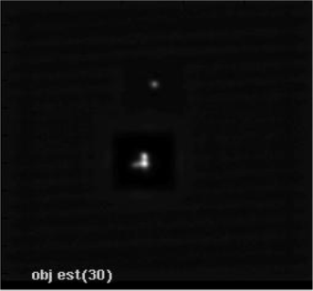
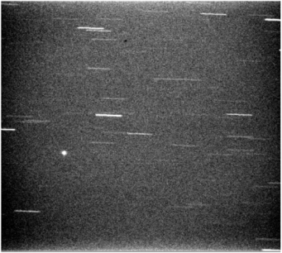
Mission Overview
Oculus-ASR (Attitude & Shape Recognition)
Collaboration with
Air Force Maui Optical and Supercomputing Observatory (AMOS)
Air Force Research Lab (AFRL)
Can we determine a satellite’s attitude and detect shape changes from the ground using only information gained from unresolved optical images?

Slide 6
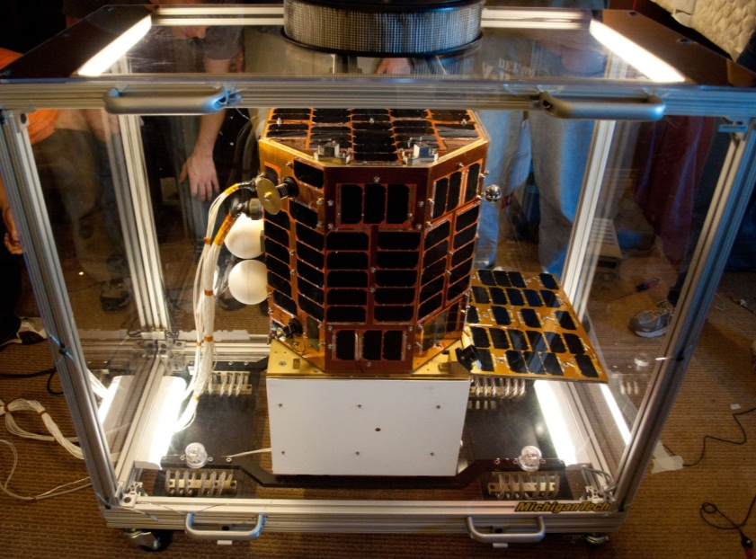
Mission Overview
Satellite Design
Colored Surfaces
Spectral Characterization of Satellite
Deployable Panels and Releasable Spheres
Configuration Changes
Attitude Control
Magnetic Torque Rods
Attitude Knowledge
Magnetometer and Gyros
Full Cooperation with AFRL

Slide 7
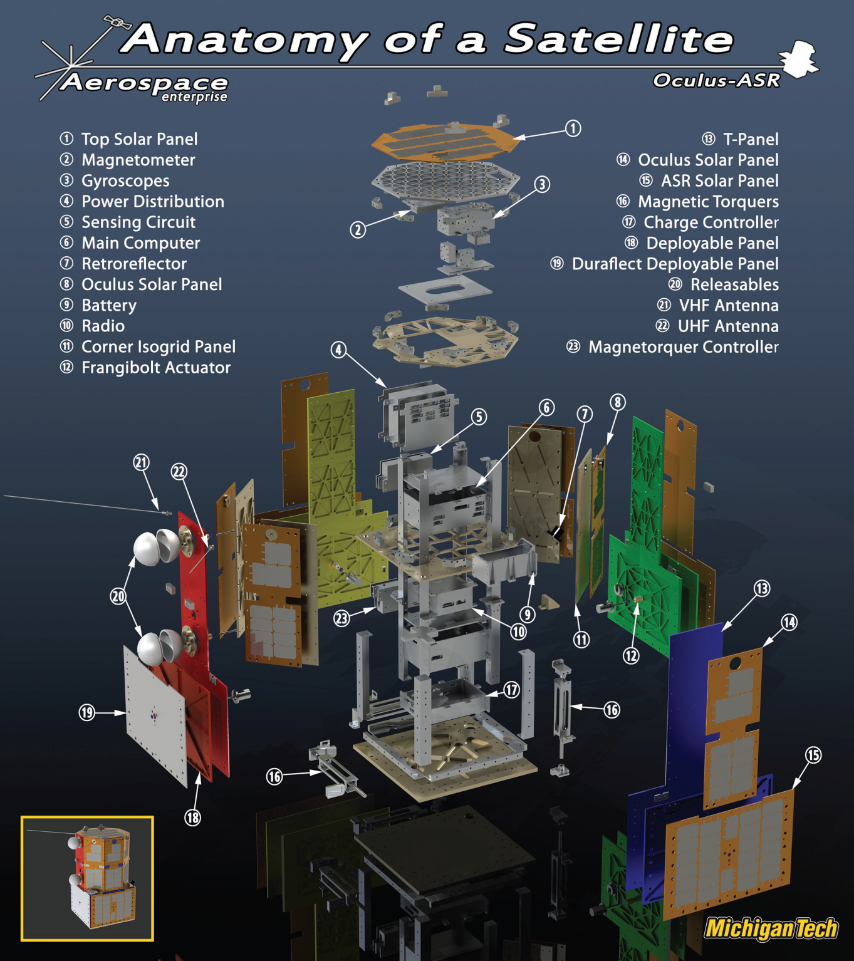
Mission Overview

